Slide 1

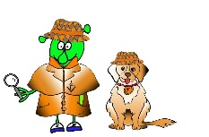

French Y3 Stage 1 Summer 1 Hungry Giant
Language Detectives’ Memory Bank of “Hungry Giant” fruits and vegetables
Fruits and Vegetables Bank
Une pomme –an apple
Une banane- a banana
Une pêche- a peach
Une grappe de raisin- a bunch of grapes
Une tomate- a tomato
Une carotte- a carrot
Une orange- an orange
Une poire- a pear
Un melon- a melon
Un concombre- a cucumber
Grammar
We often add “s” at the end of the word in French to make the noun a plural word e.g. une pomme/ deux pommes
Sound spelling
“omme”
“oi”
“on”
“ais”
“aît”
Fact Bank
Grapes are grown in France. As you drive along the roads you can see rows and rows of vines with grapes growing on them.
“Asking politely phrases” bank
Je voudrais- I would like…
s’il vous plaît - please

